Slide 1
PHOTO ALBUM OF THE WEEK
Evatese blog
Evatese blog
Notes:
This template can be used as a starter file for a photo album.

Slide 2
20th – 28th July 2012
Introducing
Courtsey :
celeb spy
Us magazine

Slide 3
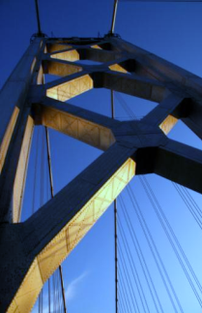
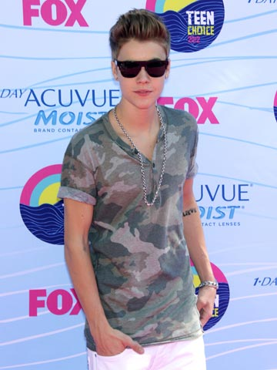
Selena Gomez chats on her mobile as she heads for lunch in LA's Sherman Oaks on 23 July 2012
Justin Bieber joins the stars on the red carpet for the 2012 Teen Choice Awards in LA.

Slide 4
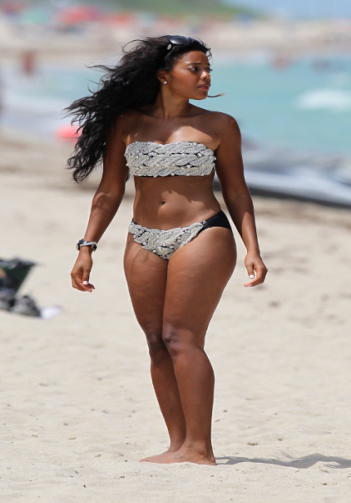
Angela Simmons in Miami
Again in a jeweled-black two piece bikini

Slide 5
Stunning in a purple belted frock, Kelly Brook reveals a sultry darker 'do at the launch of Magnum's Pleasure Pod in London

Slide 6
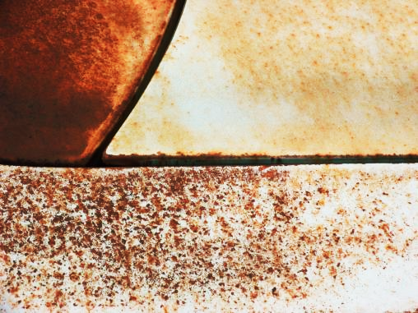
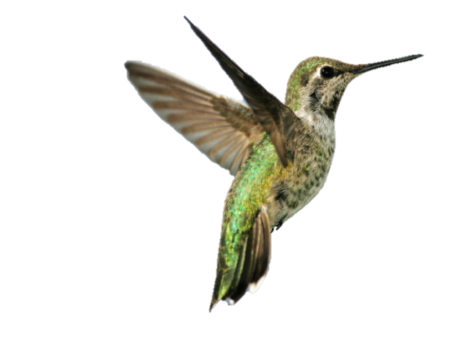
Eva Longoria munches crisps at the launch of the Do Us a Flavor Contest at the Lay's Brand Pop-Up Store in New York's Times Square

Slide 7
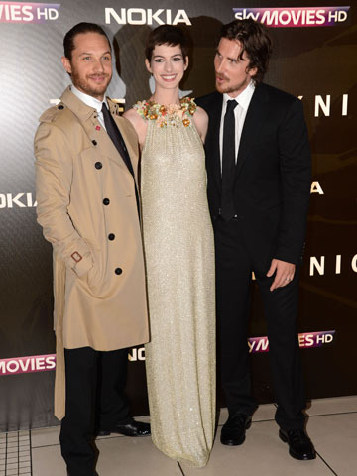
Tom Hardy, Anne Hathaway and Christian Bale work the red carpet at the European premiere of The Dark Knight Rises in London on 18 July 2012.

Slide 8
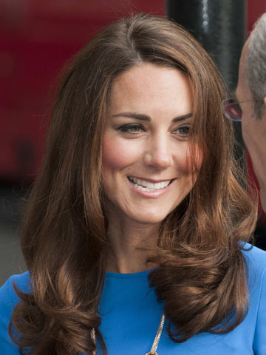
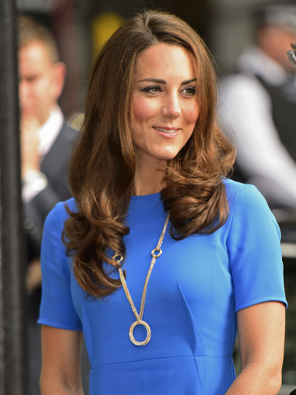
Snapshots
Mechanical Flower
KATE MIDDLETON AT NATIONAL PORTRAIT
GALLERY IN LONDON FOR OLYMPIC
EXHIBITION

Slide 9
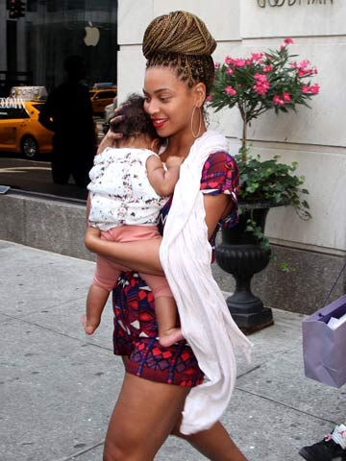
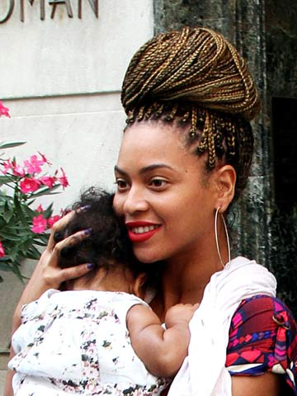
BEYONCE KNOWLES
Beyoncé Knowles steps out in New York with her beautiful baby girl Blue Ivy Carter on 18 July 2012.

Slide 10
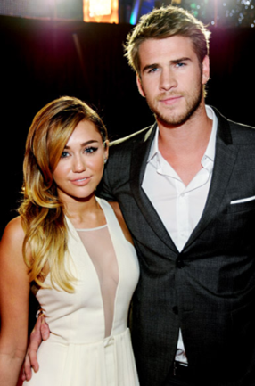
COUPLE OF THE WEEK

Slide 11
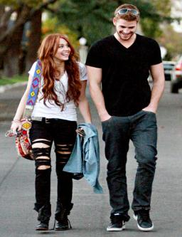
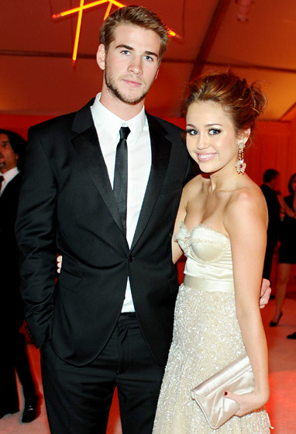
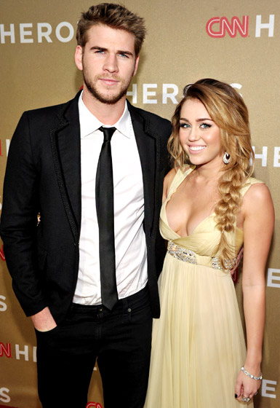
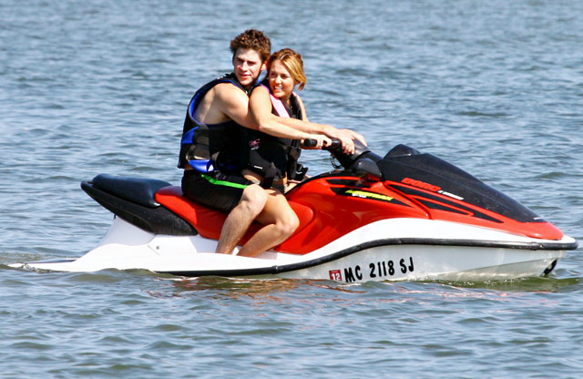
The pair (at the People's Choice Awards in L.A. in January 2012) announced their engagement in June 2012
MILEY CIRUS AND BOO
18th Annual Elton John AIDS Foundation Oscar party in West Hollywood in 2010
Visit to Ashley tisdale
Jet skiing in orchard lake Michigan July 2011
@ CNN heroes
Perfect pair

Slide 12
TEEN CHOICE AWARD 2012

Slide 13
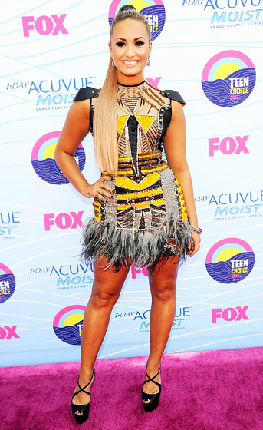
SELENA GOMEZ
CARLY RAE JEPSEN
ivory blazer and shorts with palm tree print detail by Lisa Ho, which she paired with a Kate Spade New York clutch and Aldo platform pumps.
DEMI LOVATO
LEA MICHEAL
In a Falguni + Shane Peacock dress and Christian Louboutin heels
Versace dress, Versace shoes, a Marchesa bag and Stephen Webster jewels.
TAYLOR SWIFT
Maria Lucia Hohan dress, Prada heels, Lorraine Schwartz jewels and an Edie Parker clutch.
KRISTEN STEWART
Roberto cavalli

Slide 14
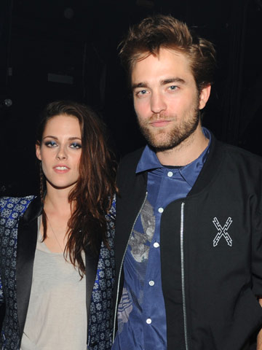
Notes:
Robert Pattinson and Kristen Stewart join Justin Bieber for the Teen Choice Awards 2012 in LA
Teen Choice Awards 2012: Kristen Stewart and Robert Pattinson
Robert Pattinson and Kristen Stewart dodge the carpet but are caught backstage looking happy and relaxed at the Teen Choice Awards 2012 at theGibson Amphitheatre at Universal CityWalk in LA.

Slide 15
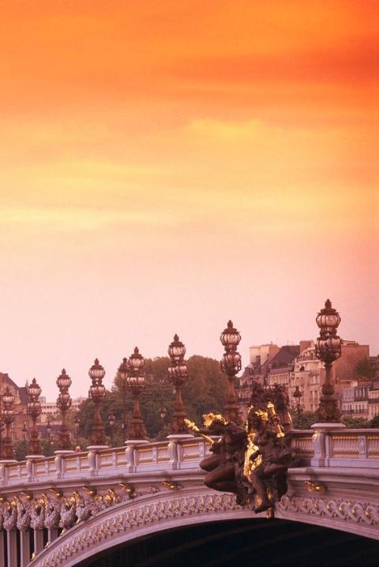
DAVIDO ALBUM LUNCH
Photo credit : Bella naija

Slide 16
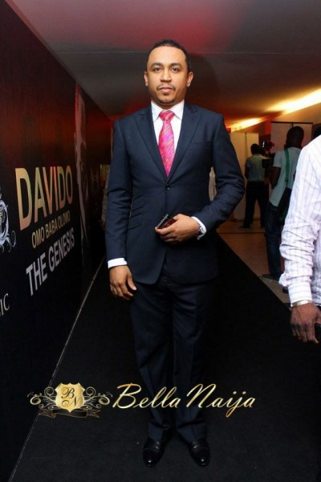
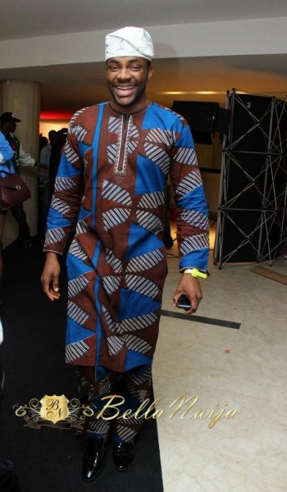
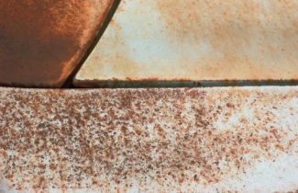
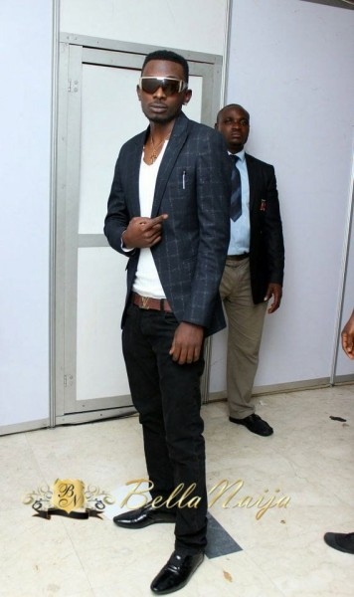
MUNACHI FREEZE EBUKA
MAYD
SASHA
ADURE ACHUMBA

Slide 17
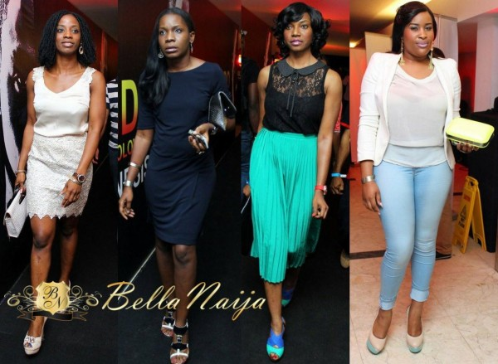
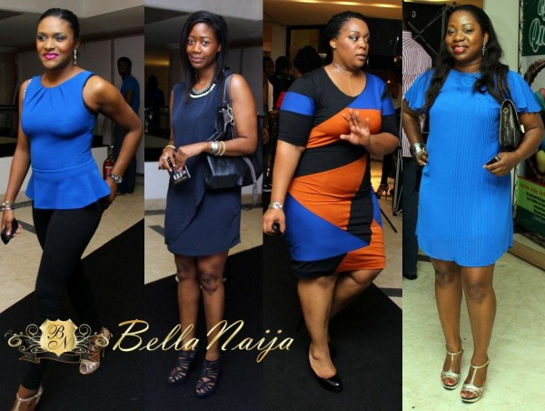
Contrast
Sharpness

Slide 18
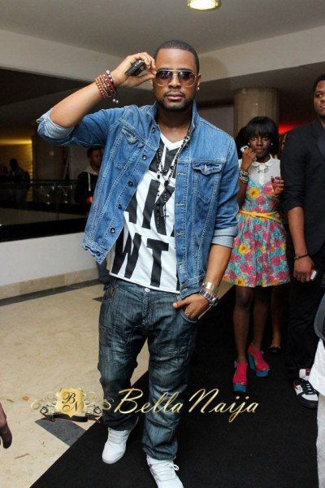
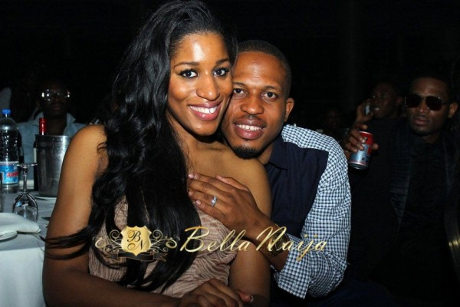
NAETO C AND WIFE
MOCHEDDA
DEMI LOVATO
LINDA IKEJI
DJ EXCLUSIVE
FUNKE AKINDELE-OLOYEDE
EKU EDEWOR

Slide 19
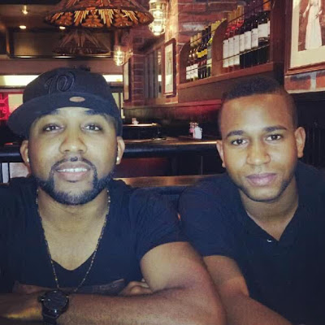
His name is Funmi Wellington and according to Banky, he's single. Interested ladies can like to follow him on Twitter @F_DoubleU. #thankmelater :-)

Slide 20
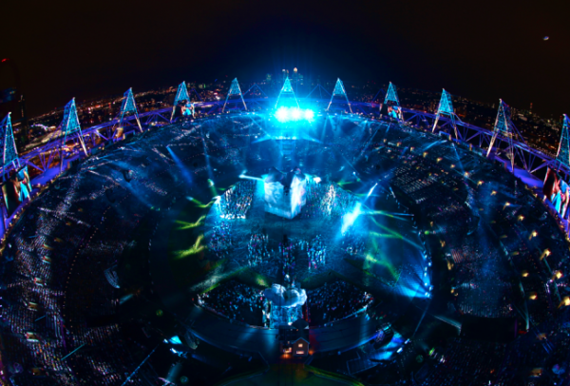
OLYMPICS 2012 OPENING CEREMONY

Slide 21
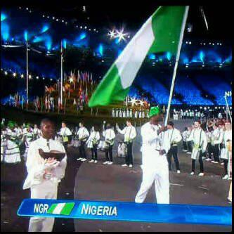
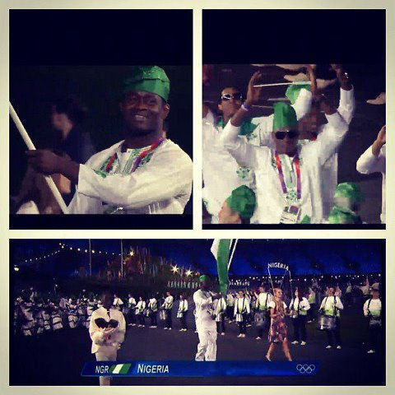

Slide 22
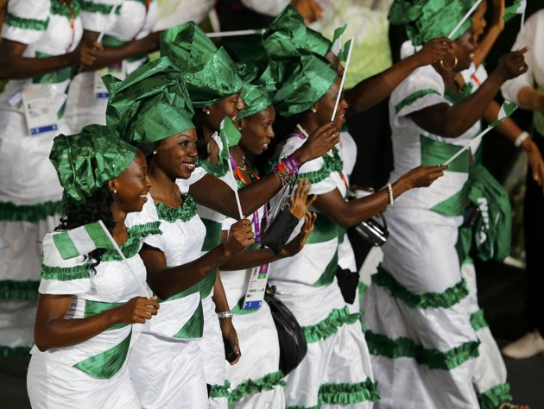
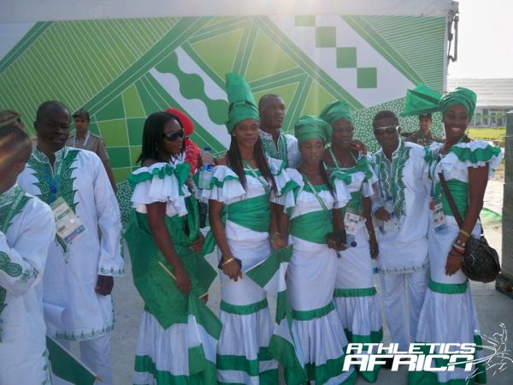

Slide 23
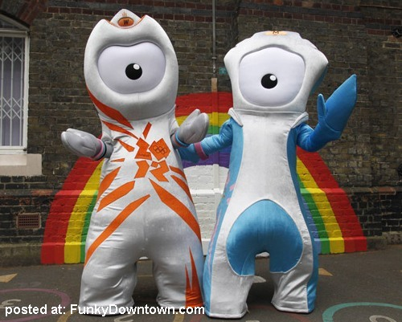
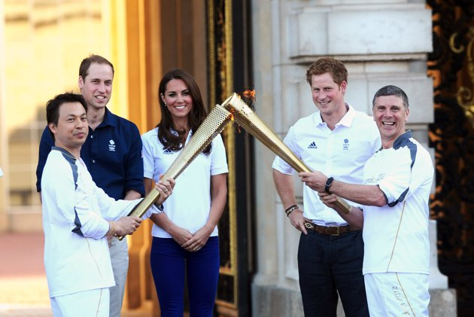
Olympic mascots
Prince William, Duke of Cambridge, Catherine, Duchess of Cambridge and Prince Harry watch Wai-Ming hand over the London 2012 Olympic Torch to John Hulse during a visit to Buckingham Palace

Slide 24
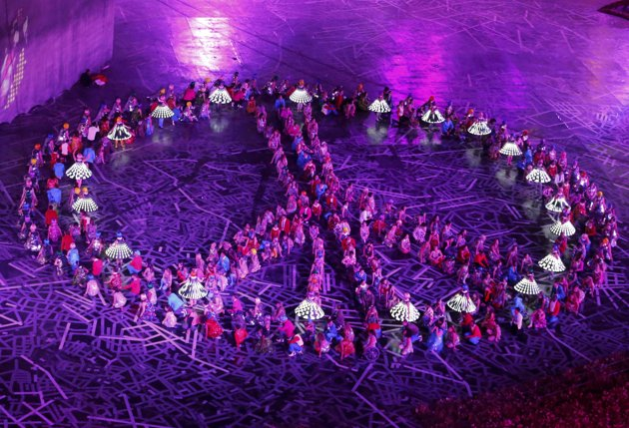
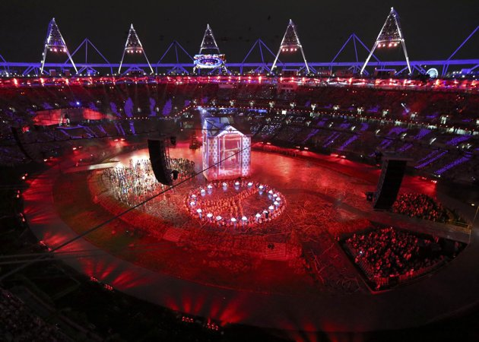
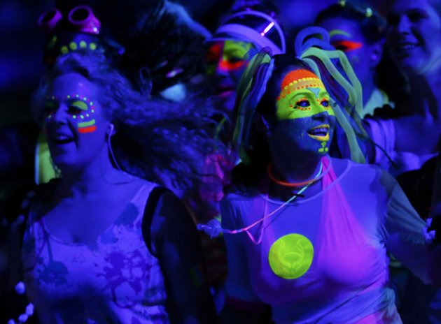
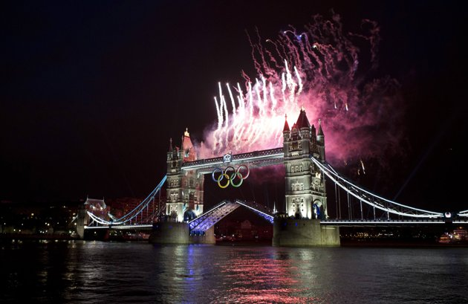
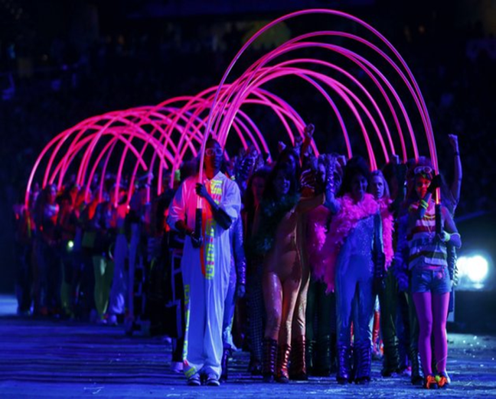
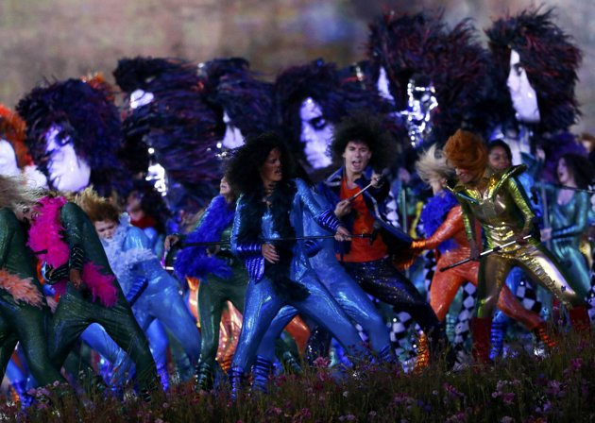

Slide 25
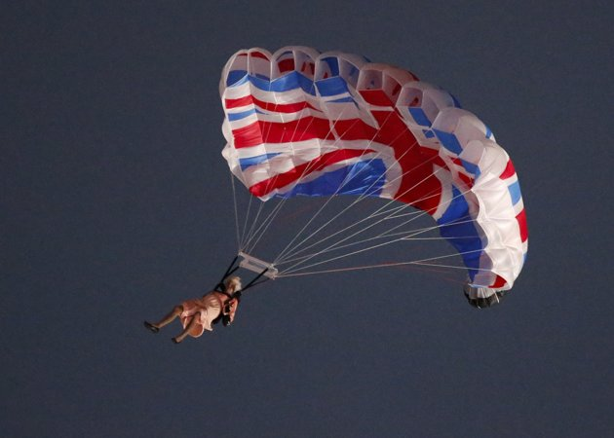
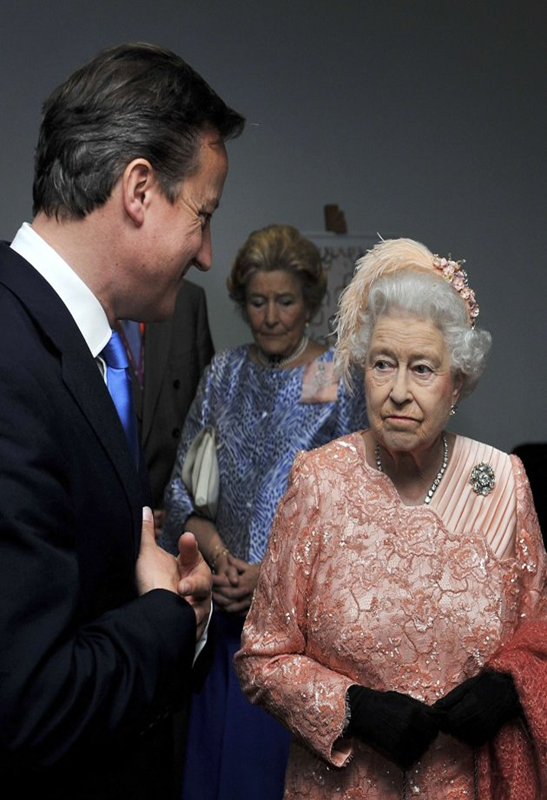
The queen enters in james bond style

Slide 26
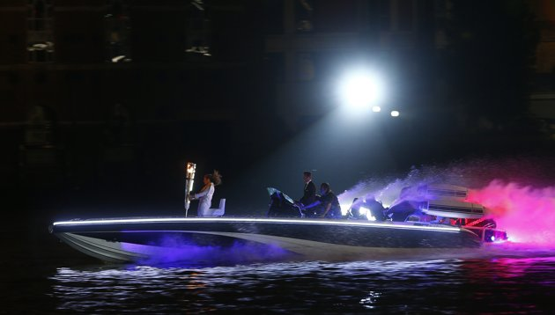
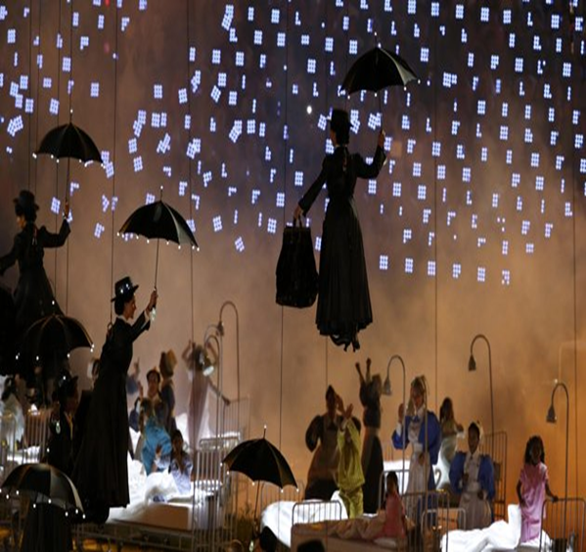
Britain's David Beckham (C) drives a powerboat with the Olympic torch as fireworks are launched over Tower Bridge

Slide 27
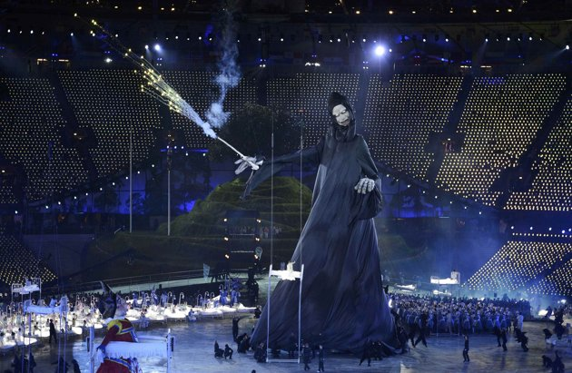
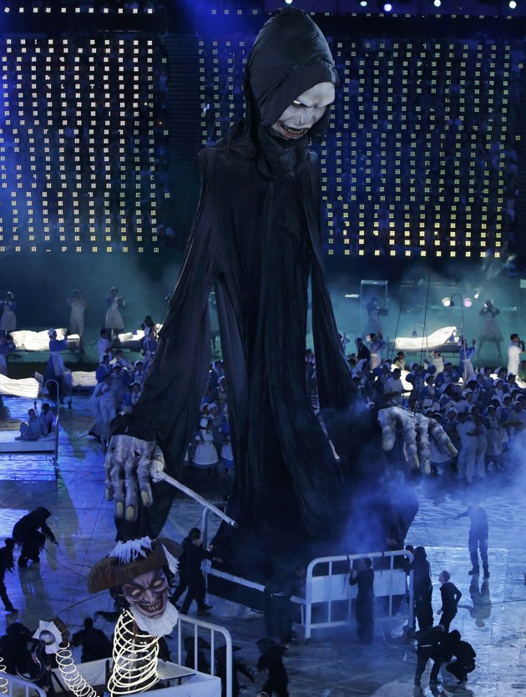
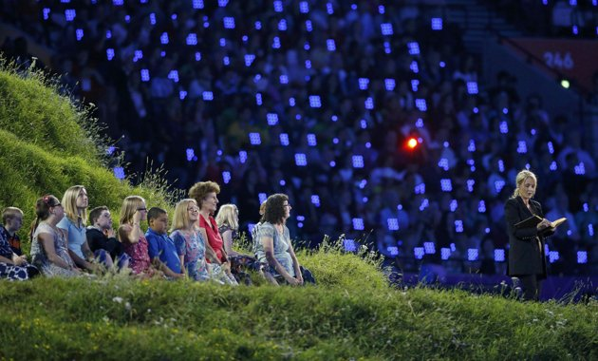
Notes:
J.K. Rowling, author of the Harry Potter fantasy series, reads during the opening ceremony

Slide 28
